Slide 1
Regional Models – The Conceptual Model Approach
CE 547 – BRIGHAM YOUNG UNIVERSITY

Slide 2
Modeling Approaches in GMS
Grid Approach
User first builds a 3D grid and then selects cells and assigns properties, sources/sinks, etc directly to cells
Works well for simple models
Conceptual Model Approach
User builds a “conceptual model” and assigns properties (K, pumping rates, recharge, etc) directly to points, lines, and polygons defining the model
Grid is created and model features and properties are automatically derived from conceptual model and assigned to grid cells
Best solution for complex regional models

Slide 3
Basic Steps
Establish a base map
Define a projection (coordinate system)
Select units
Build a conceptual model
Convert to numerical model

Slide 4
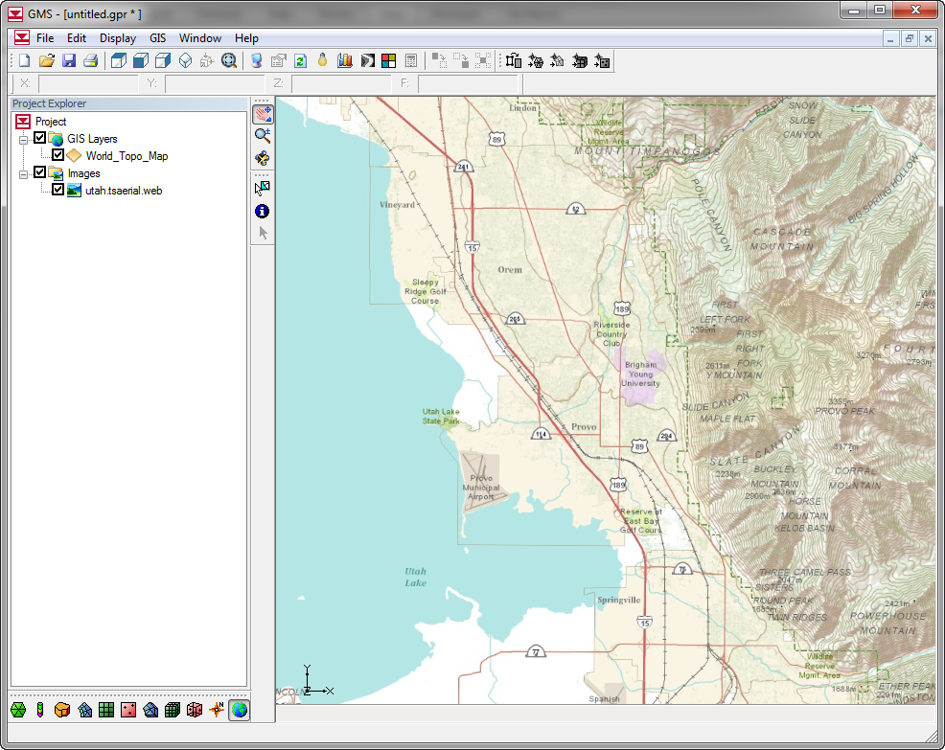
1. Establish a Base Map
Provides a reference for on-screen editing
Enhances display of model data

Slide 5
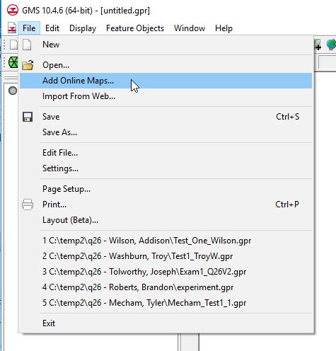
Online Maps
Creates a dynamic basemap that refreshes when you pan or zoom
Uses ESRI web mapping services

Slide 6
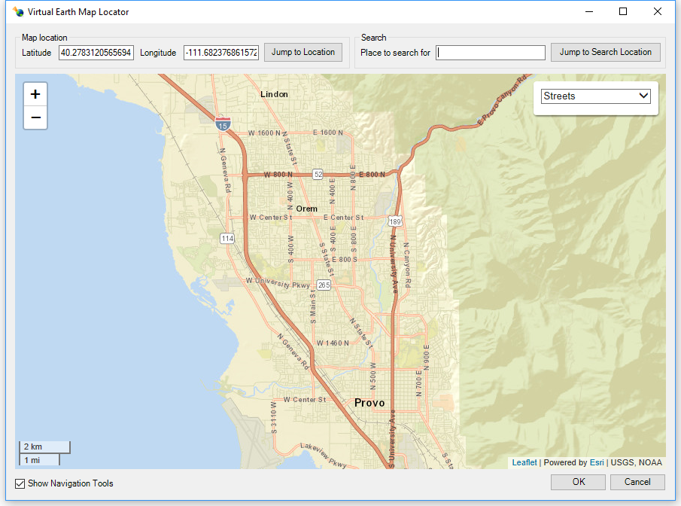
Map Locator
Zoom to model region
Limits focus of basemap download to selected region only

Slide 7
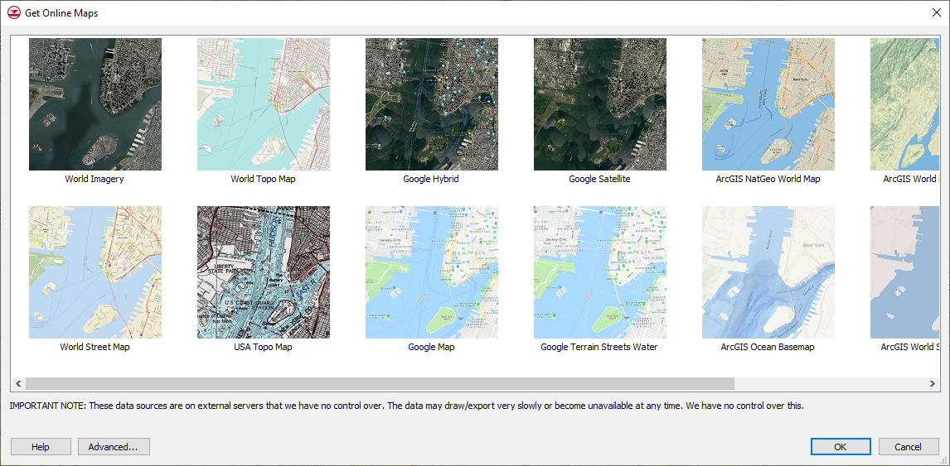
Select preferred map

Slide 8
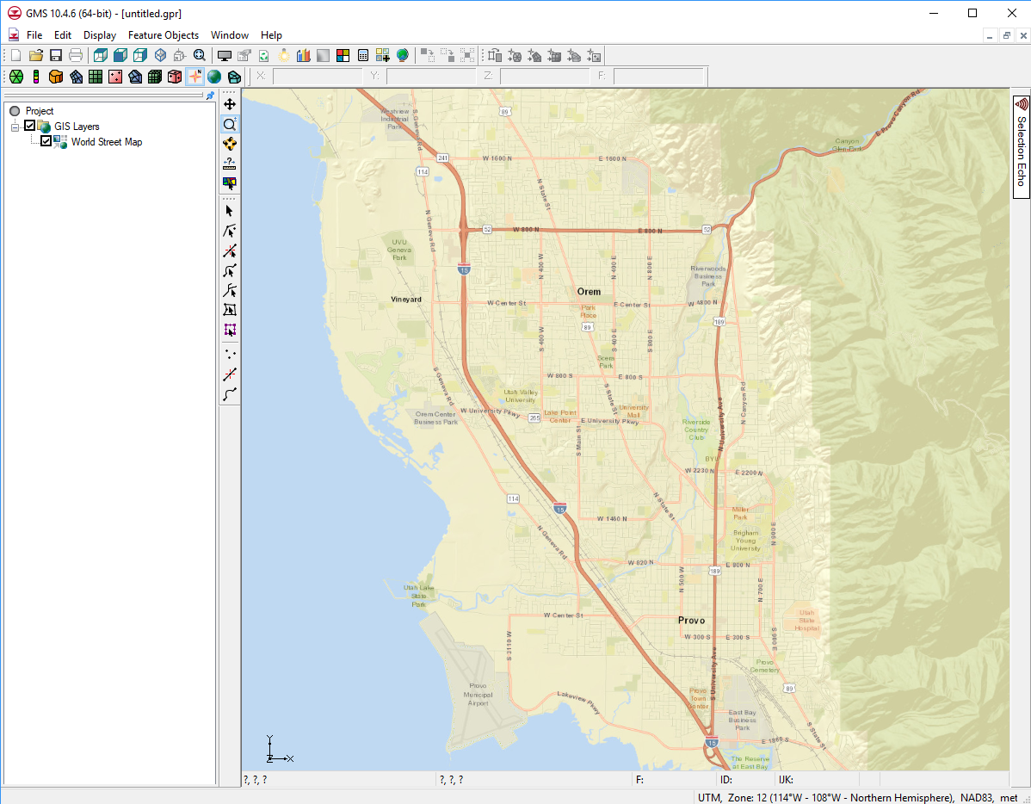
Base map automatically refreshes when panning or zooming

Slide 9
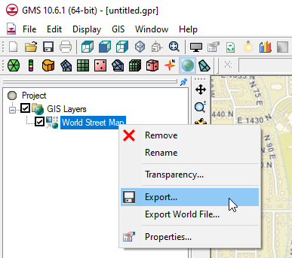
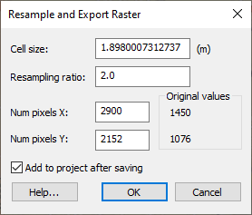
Basemap Tiling/Local Refresh
Refreshing basemap from web service each time you pan or zoom can be time-consuming, especially if you have limited bandwidth.
You can create a local, tiled basemap by right-clicking on map and selecting export. This local copy is automatically added to project and refreshes more rapidly.

Slide 10
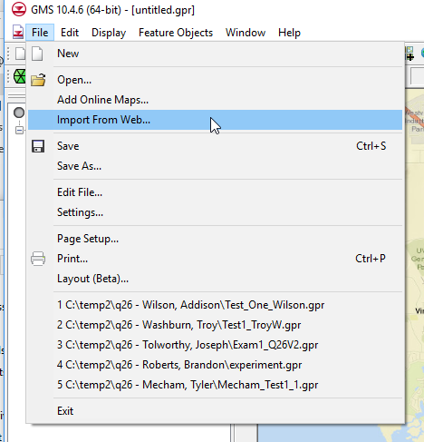
Import Data From Web
Similar to adding a basemap, but provides access to broad range of data from web services (DEMs, soil maps, land cover, etc.)

Slide 11
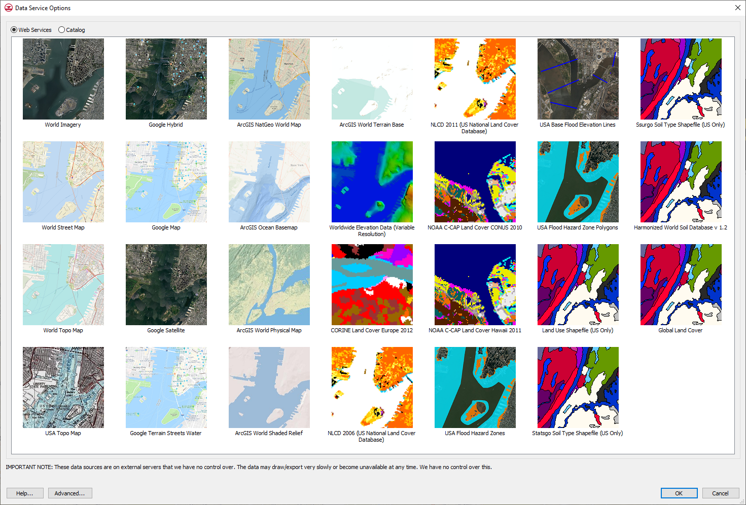

Slide 12
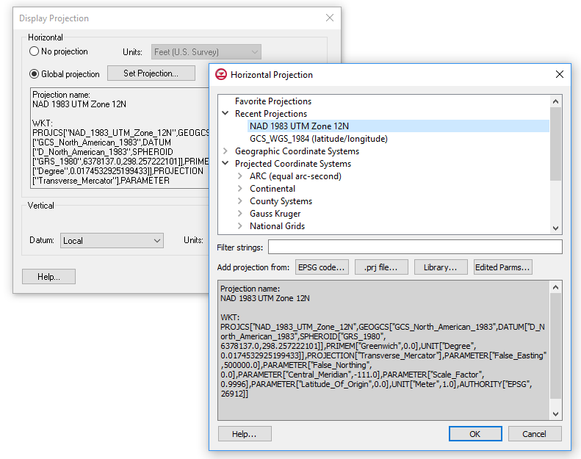
2. Select a Projection
Defines default coordinate system for project
Imported data with a defined projection (shapefiles for example) will automatically be displayed in the correct location
Display|Display Projection…
Note: You will be prompted to select a projection when you set up your basemap.

Slide 13
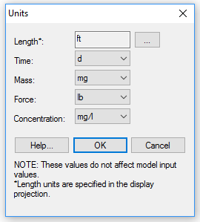
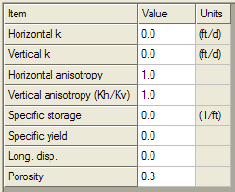
3. Select Units
Edit|Units…
Controls text labels displayed in interface as a units reminder
Helps ensure consistent units
Length unit has to be consistent with selected projection

Slide 14
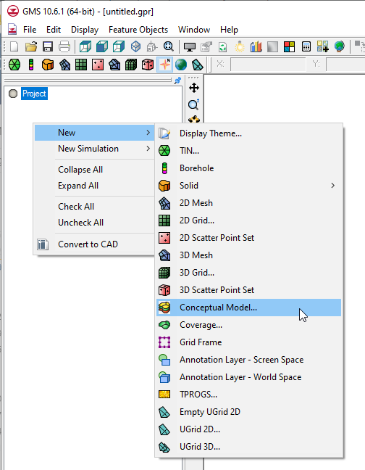
4. Build a Conceptual Model
Definition
A grid-independent representation of major model features including aquifer properties, boundary conditions, and sources/sinks
Purpose
Automatically discretize model input for MODFLOW

Slide 15
Conceptual Model - Site Map

Slide 16
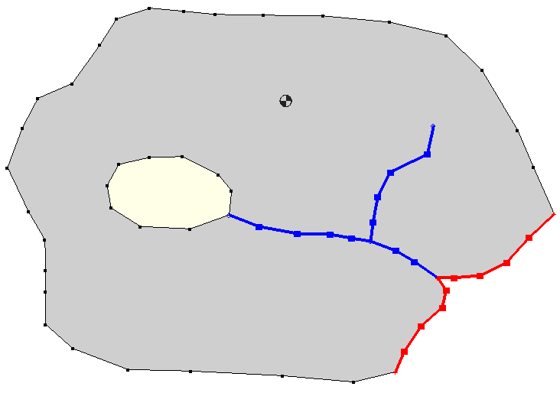
Feature Objects
Well Point
General Head Polygon
River
Arcs
Variable Head Polygon
Specified Head Arcs

Slide 17
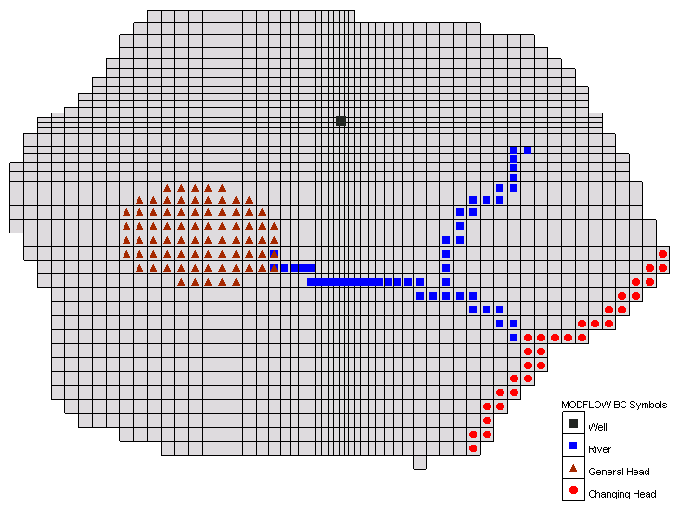
Grid-Based Numerical Model

Slide 18
Types of Feature Objects
Point
Node
Vertex
Arc
Polygons

Slide 19
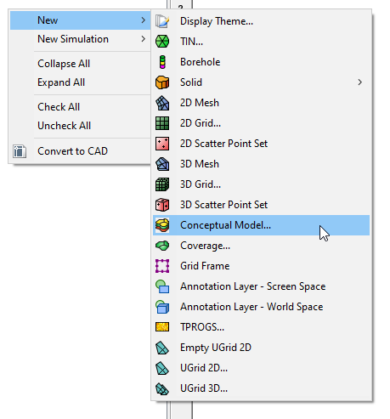
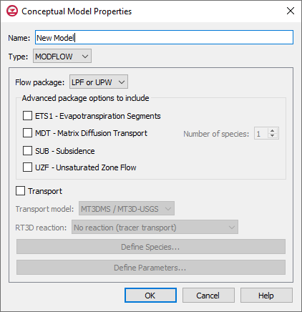
a) Build Conceptual Model Object
Used to organize conceptual model data
Consists of one or more coverages

Slide 20
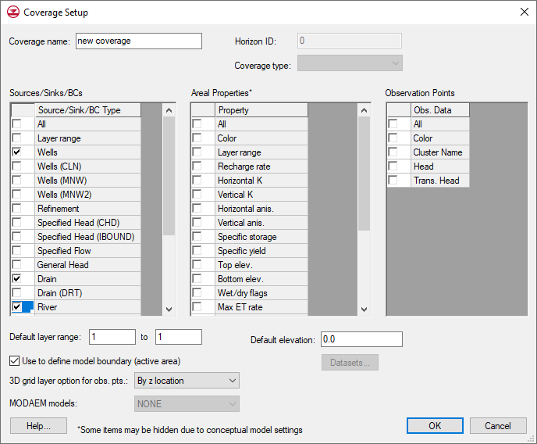
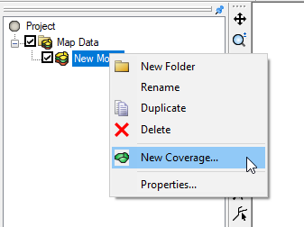
b) Build MODFLOW Coverages
Collection of related feature objects
Select desired properties

Slide 21
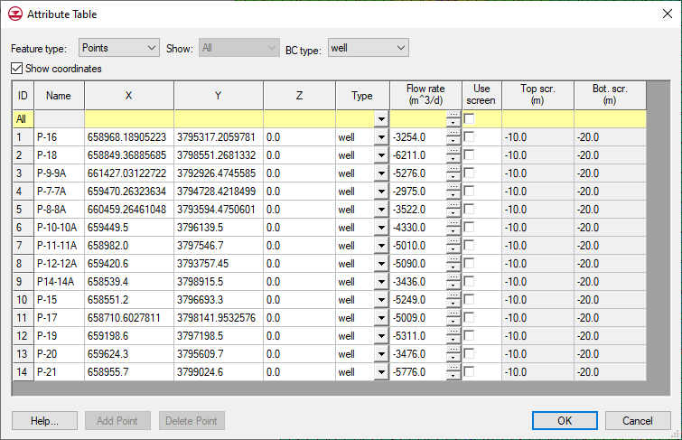
Sample Feature Object Properties

Slide 22
Conductances
Many of the objects in the Source/Sink category must be assigned a conductance value.
For arcs
the conductance should be assigned on a conductance per length basis.
For polygons
the conductance should be assigned on a conductance per area basis.
GMS computes length or area and computes and assigns the appropriate value.

Slide 23
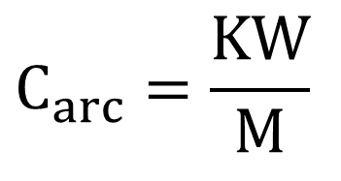
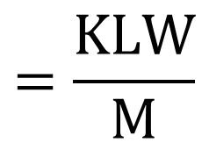
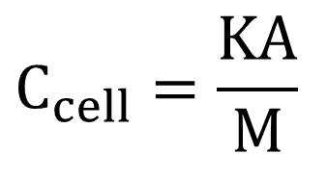
Arc Conductance
$$C_{cell}=\frac{KA}{M}$$
$$=\frac{KLW}{M}$$
$$C_{arc}=\frac{KW}{M}$$

Slide 24
Arc Conductance Example

Slide 25
Polygon Conductance

Slide 26
Polygon Conductance Example

Slide 27
5. Convert to Numerical Model

Slide 28
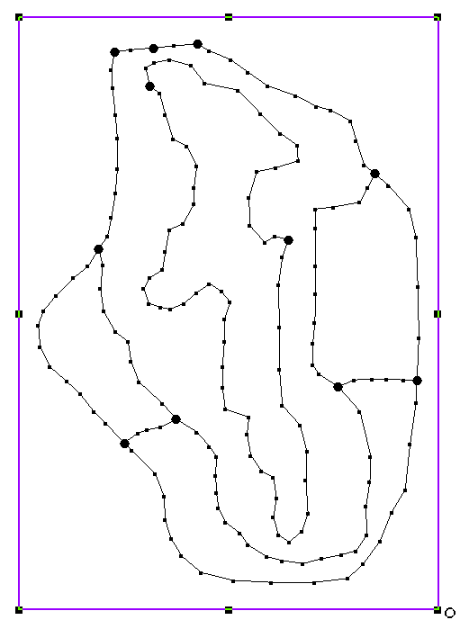
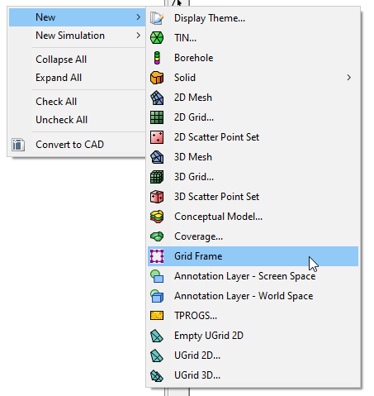
a) Define the Grid Frame
Defines location of grid relative to conceptual model
Can be used to rotate the grid
Use Grid Frame tool to edit

Slide 29
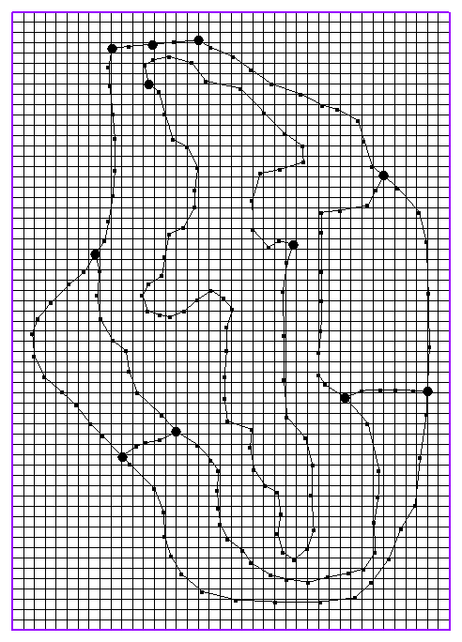
b) Build the Grid
Select “Map → 3D Grid” command from Feature Object menu
Creates grid that fills grid frame

Slide 30
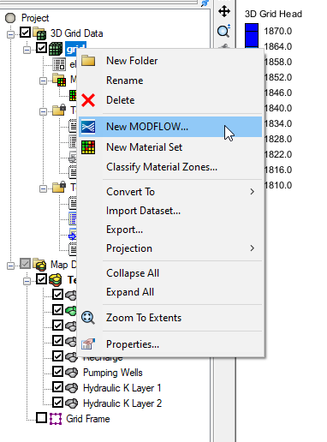
c) Initialize MODFLOW
Right-click on 3D Grid and select “New MODFLOW” or
Select “New Simulation” command in MODFLOW Menu
Initializes MODFLOW settings and data

Slide 31
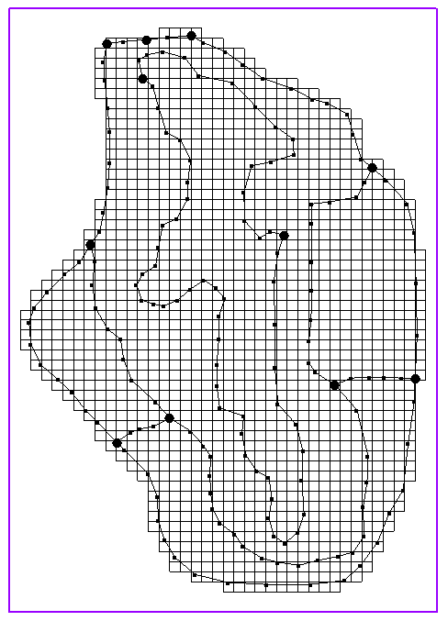
d) Activate Cells in Coverage
Select the “Activate Cells in Coverage(s)” command in Feature Objects menu
Inactivates all cells outside of conceptual model boundary

Slide 32
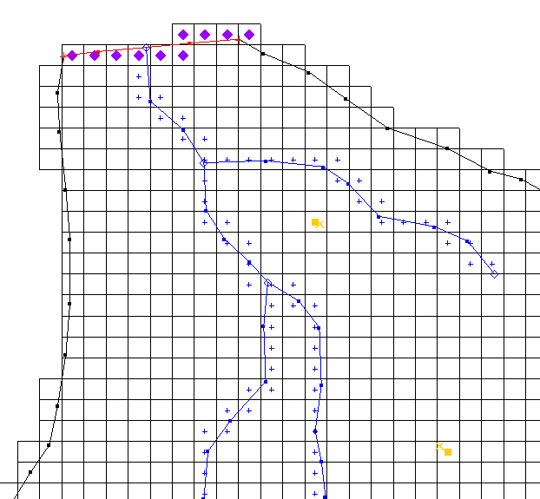
e) Map → MODFLOW
Right-click the conceptual model in Project Explorer or Select the “Map → MODFLOW” command
Discretizes model input and populates package data

